Slide 1
PROJECT:
ASCII
SPACE INVADERZ!

Slide 2
PRESENTED TO YOU BY:
BIGYAPTI BASHYAL - PUL076BCT016
ISHANI MALLA - PUL076BCT028
MAHIMA DHALKA - PUL076BCT033
NISAN SHRESTHA - PUL076BCT040

Slide 3
Preface:
Restoration of the classic retro game Space Invaders.
In C using basic ASCII characters.
GCC compiler shipped with Code::Blocks.
Not fully compatible with ‘Out-of-the-box TURBO C++’
Standard keyboard input to interact.

Slide 4
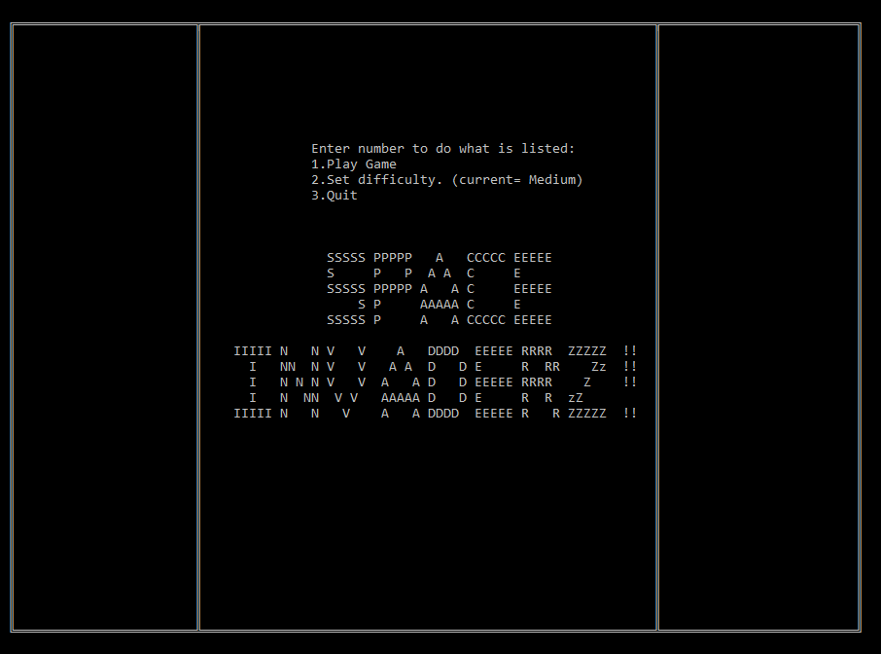

Slide 6
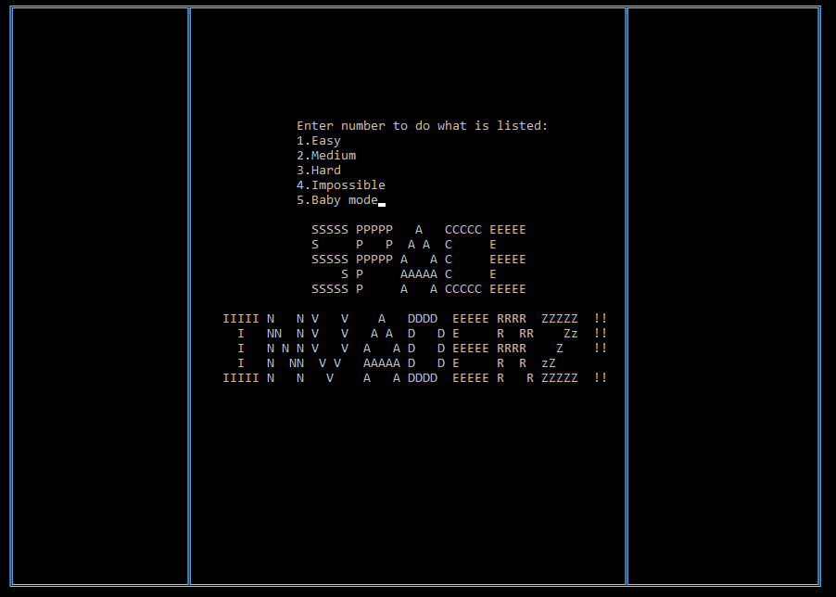

Slide 7
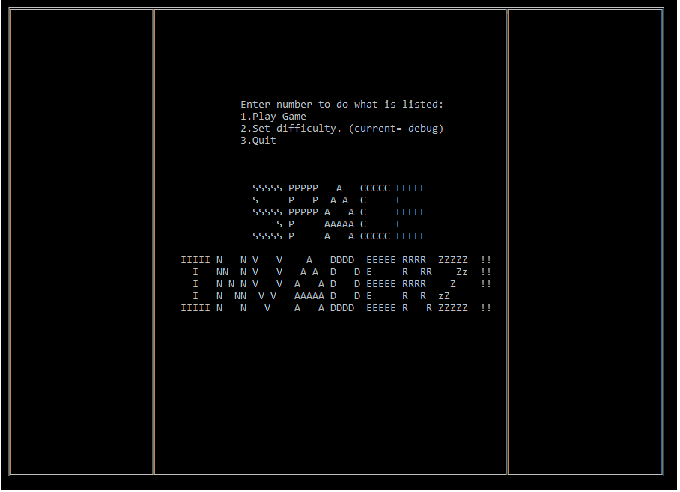

Slide 8
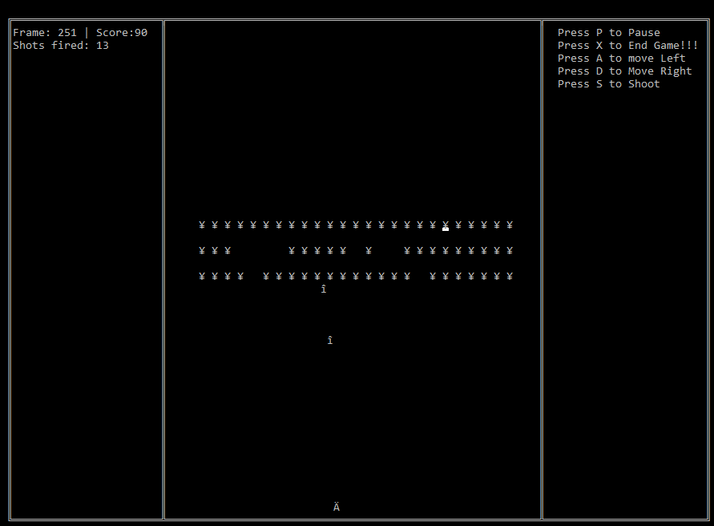

Slide 9
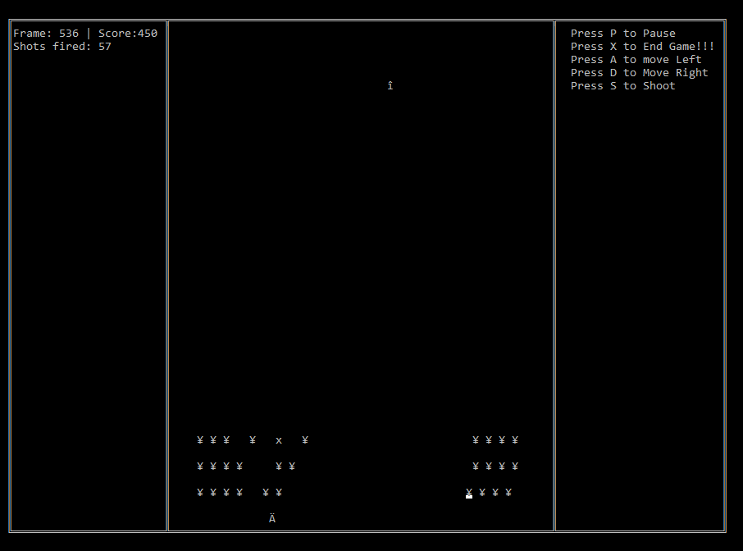

Slide 10
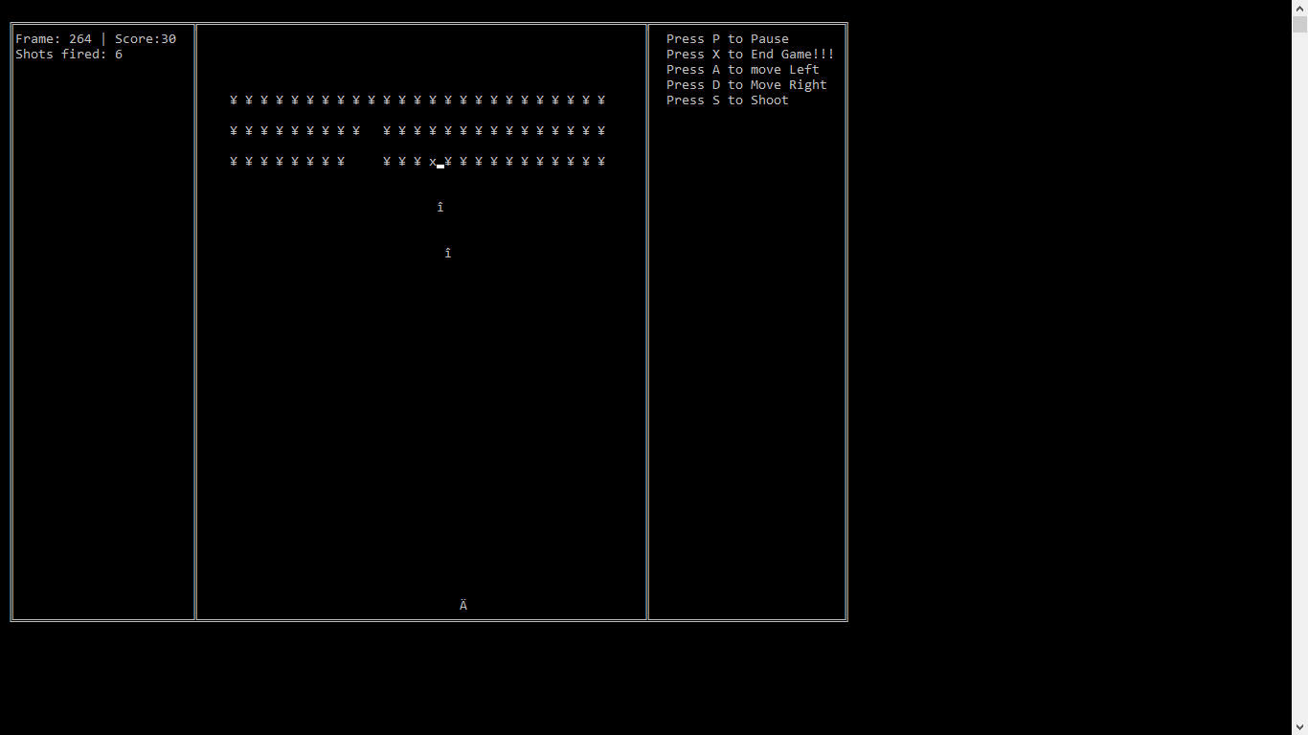
COLLSIION:

Slide 11
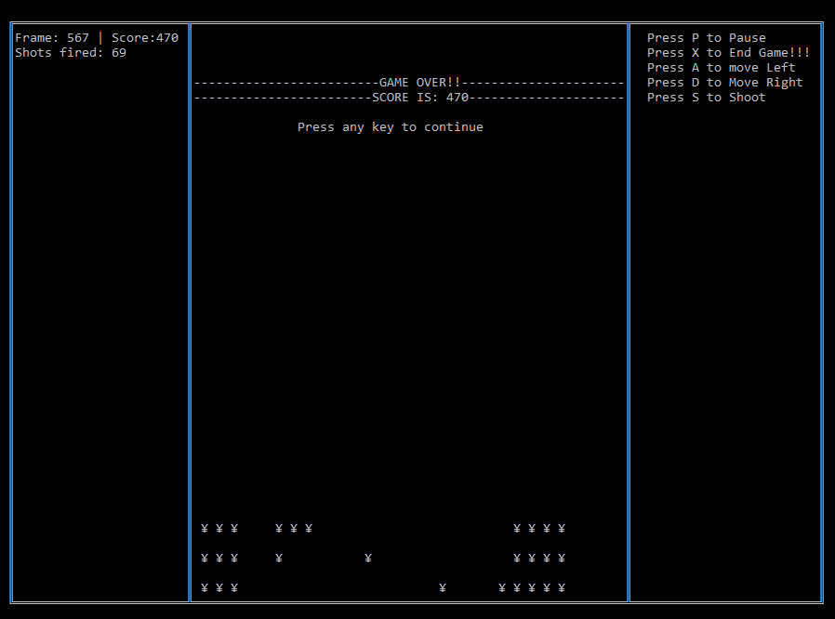

Slide 13
Approach:
2 major structs ; OBJECT and BULLET
Divided into functions.
Infinite game loop until Game Over.
Non Blocking Input via function kbhit(); and getch();
Phantom (non printing) objects to compute movement of enemy and Game over condition.
Dynamically printing to avoid flicker using gotoxy();

Slide 14
For More
LETS GO TO THE CODE:

